Slide 1
Amir Ghaderi MSc Data Science and Analytics
Classification of Credit Card Defaults

Slide 2
Overview
Dataset Description
Project Goals
Data Pre-Processing
Visualization walk throughs
Conclusions
Lessons learned

Slide 3
Dataset: Default Payments of Credit Card
Source: UCL Machine Learning Repository - Kaggle
Records: 30000
Features:25
{Id, Limit, sex, education, marriage, age, Payment1:6, Bill_amount1:6, Pay_amount1:6, Default_Class}
Classes: 2
0 – Not Default
1 – Defaulted

Slide 4
Project Goals
1. Which variables are the strongest predictors of default payments
2. What is the most accurate Machine Learning Classification Model

Slide 5
Data Pre-Processing
Conducted using R
Class Factorization
Feature Normalization
Data Splitting - training/testing
Class distribution balancing - training/testing
Data Randomization - training/testing sets

Slide 6
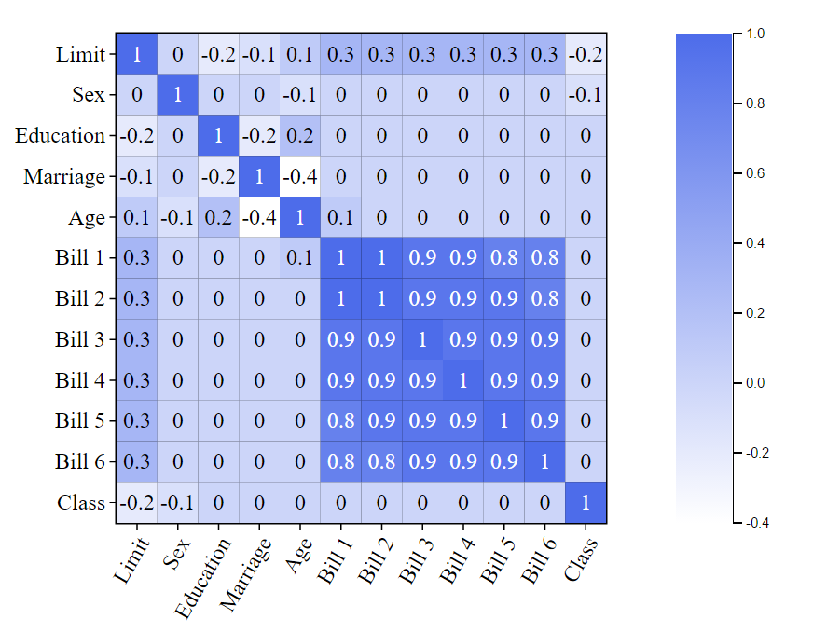
Visualization1: Correlation Matrix

Slide 7
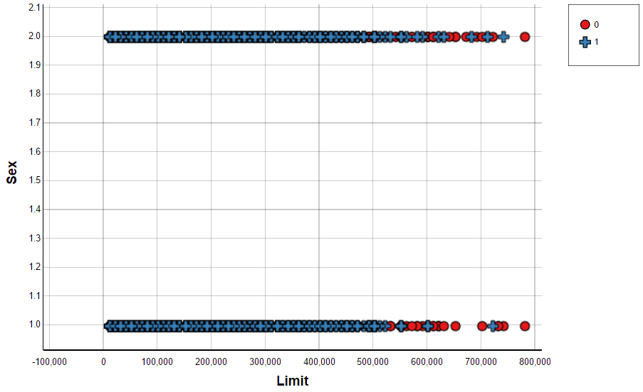
Visualization2: Scatter Plot

Slide 8
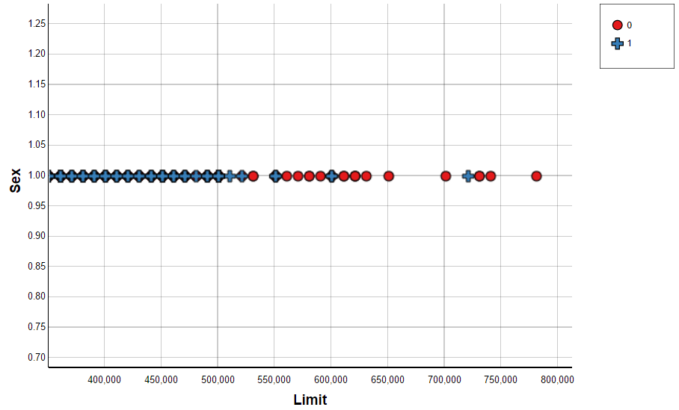
Visualization2: Scatter Plot

Slide 9
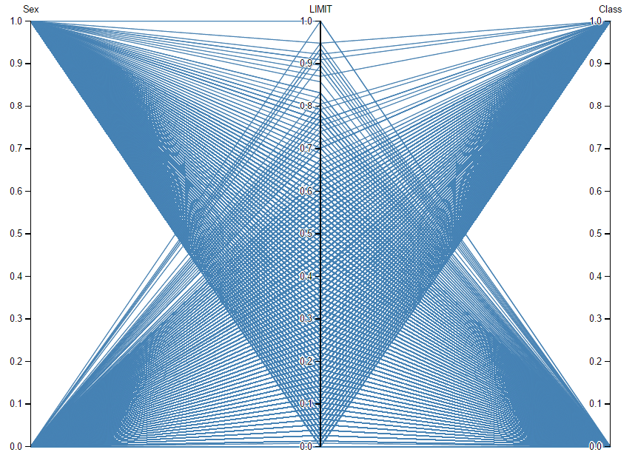
Visualization3: Parallel Coordinates

Slide 10
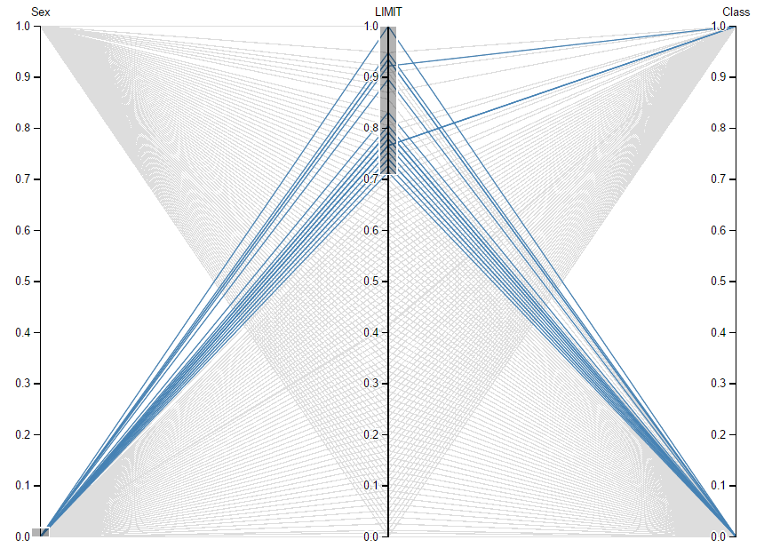
Visualization3: Parallel Coordinates

Slide 11
Machine Learning Classifiers
Knn{Euclidean, Manhattan, Minkowski, K = sqrt(n)}
SVM{Linear, Polynomial, Radial Basis, Sigmoid}
Naïve Bayes
Decision trees{tree, bagging, RF, C5.0}
Neural nets{hidden layers = sqrt(n)}

Slide 12
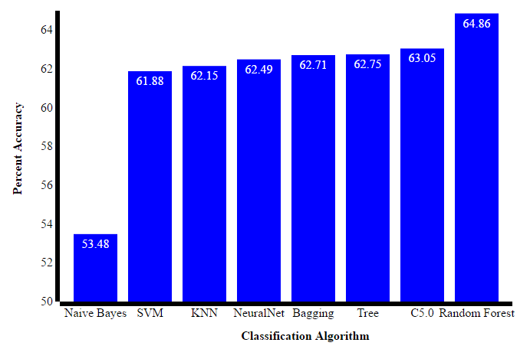
Visualization4: Bar plot

Slide 13
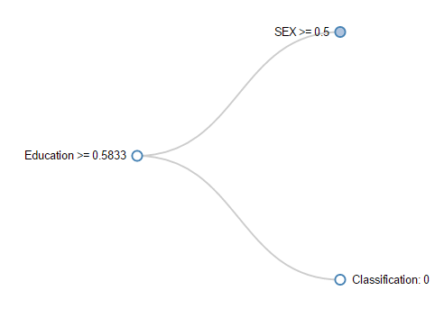
Visualization5: Decision Tree

Slide 14
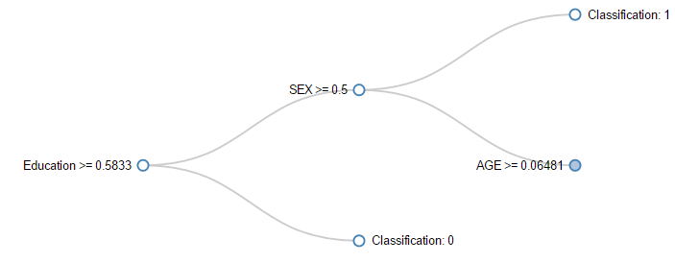
Visualization5: Decision Tree

Slide 15
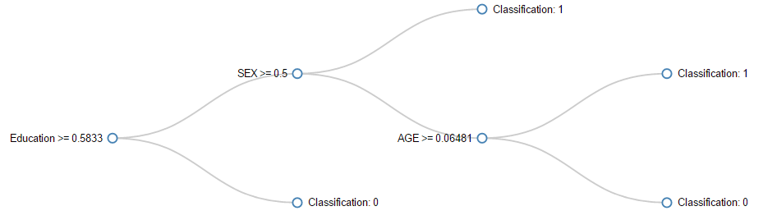
Visualization5: Decision Tree

Slide 16
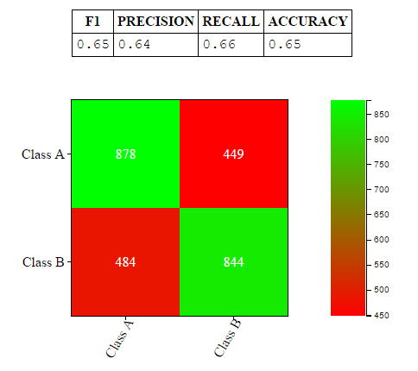
Visualization6: Confusion Matrix

Slide 17
Conclusion
Which variables are the strongest predictors of default payments?
{Limit, Sex}
What is the most accurate Machine Learning Classification Model?
Decision Trees{RF}

Slide 18
Lessons Learned
Javascript, HTML, CSS, D3 Experience
Machine Learning Classification Experience
Data manipulating experience in R
Relevant project experience
Kaggle has excellent dataset

Slide 19
References
Bar Plot - https://www.youtube.com/watch?v=Fjmxh-gnBM0
Correlation Matrix: https://bl.ocks.org/arpitnarechania/caeba2e6579900ea12cb2a4eb157ce74
Scatter Plot: https://bl.ocks.org/starcalibre/f4b8bb0da3b2090c56d79646a338fd81
Parallel Coordinates: https://bl.ocks.org/jasondavies/1341281
Decision Tree: https://bl.ocks.org/ajschumacher/65eda1df2b0dd2cf616f
Confusion Matrix: https://bl.ocks.org/arpitnarechania/dbf03d8ef7fffa446379d59db6354bac

Slide 20


